Slide 1

Learning Objective
I will solve quadratic equations by factorising.
Enter quietly, please be ready with the following on your desk:
Whiteboard
Whiteboard marker
Exercise Book
Pencil, pen, ruler and red pen
Diary
Calculator
Device – charged or borrowed from Library before maths

Slide 2
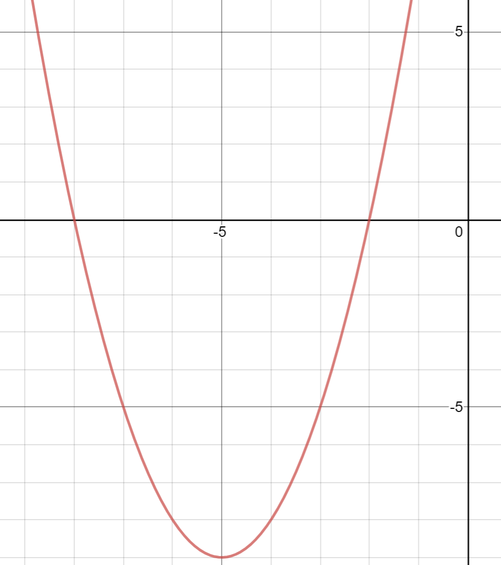

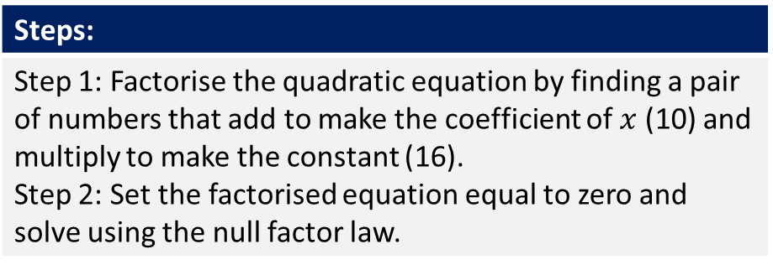


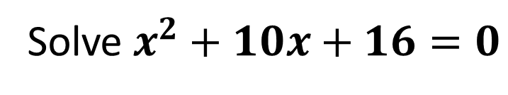




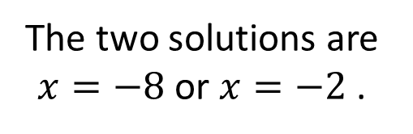
Daily Review
Steps:
Step 1: Factorise the quadratic equation by finding a pair of numbers that add to make the coefficient of $x$ (10) and multiply to make the constant (16). Step 2: Set the factorised equation equal to zero and solve using the null factor law.
Solve $x^{2}+10x+16=0$
Step 1: Adds to make 10 and multiplies to make 16
8 and 2
$$x^{2}+10x+16=\left(x+8\right)\left(x+2\right)$$
$$\left(x+8\right)\left(x+2\right)=0$$
Step 2:
$$x+8=0$$
OR
$$x+2=0$$
$$−8$$
$$−8$$
-2
-2
$$x=−8$$
$$x=−2$$
The two solutions are $x=−8$or $x=−2$ .

Slide 3
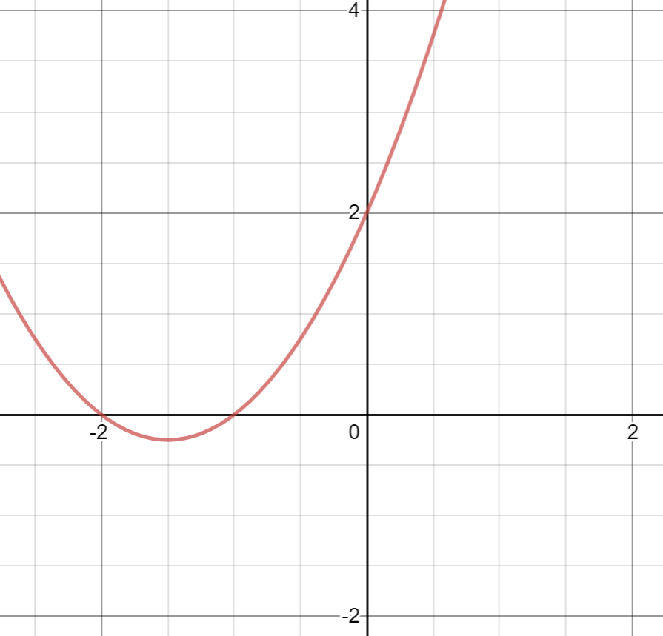
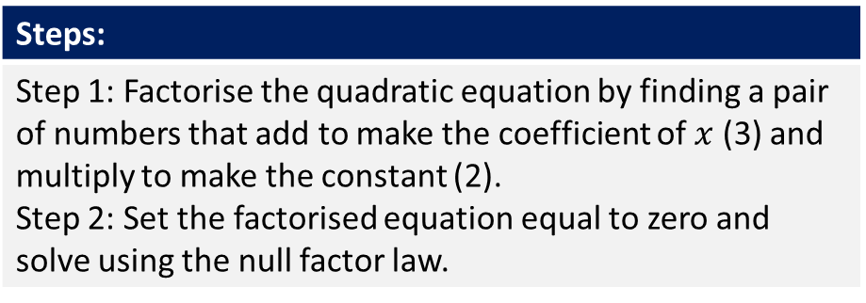

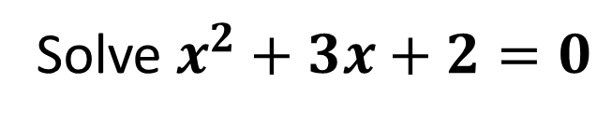




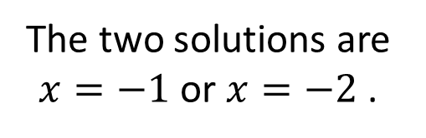
Daily Review
Steps:
Step 1: Factorise the quadratic equation by finding a pair of numbers that add to make the coefficient of $x$ (3) and multiply to make the constant (2). Step 2: Set the factorised equation equal to zero and solve using the null factor law.
Solve $x^{2}+3x+2=0$
Step 1: Adds to make 3 and multiplies to make 2
1 and 2
$$x^{2}+3x+2=\left(x+1\right)\left(x+2\right)$$
$$\left(x+1\right)\left(x+2\right)=0$$
Step 2:
$$x+1=0$$
OR
$$x+2=0$$
$$−1$$
$$−1$$
-2
-2
$$x=−−1$$
$$x=−2$$
The two solutions are $x=−1$or $x=−2$ .

Slide 4
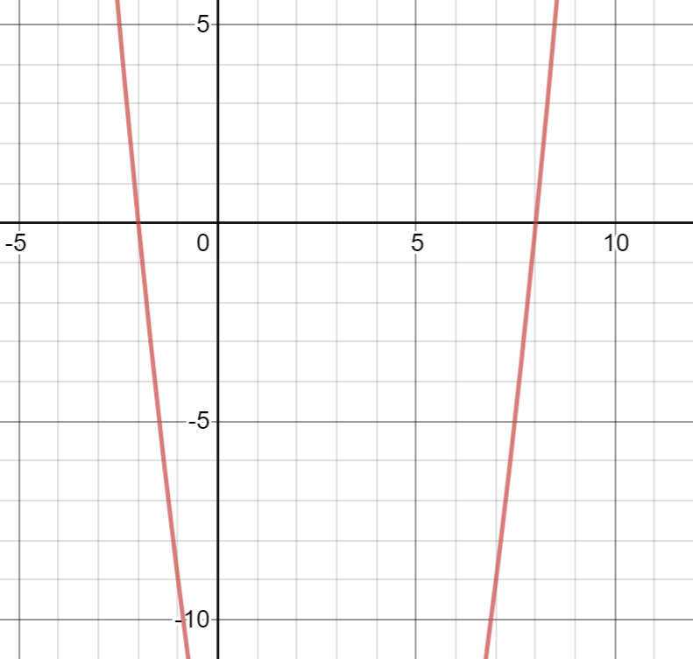
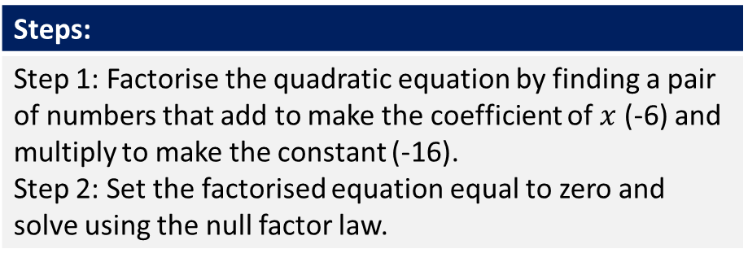

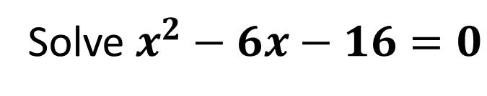




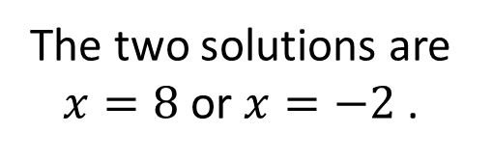
Daily Review
Steps:
Step 1: Factorise the quadratic equation by finding a pair of numbers that add to make the coefficient of $x$ (-6) and multiply to make the constant (-16). Step 2: Set the factorised equation equal to zero and solve using the null factor law.
Solve $x^{2}−6x−16=0$
Step 1: Adds to make -6 and multiplies to make -16
-8 and 2
$$x^{2}−6x−16=\left(x−8\right)\left(x+2\right)$$
$$\left(x−8\right)\left(x+2\right)=0$$
Step 2:
$$x−8=0$$
OR
$$x+2=0$$
$$+8$$
$$+8$$
-2
-2
$$x=8$$
$$x=−2$$
The two solutions are $x=8$or $x=−2$ .

Slide 5
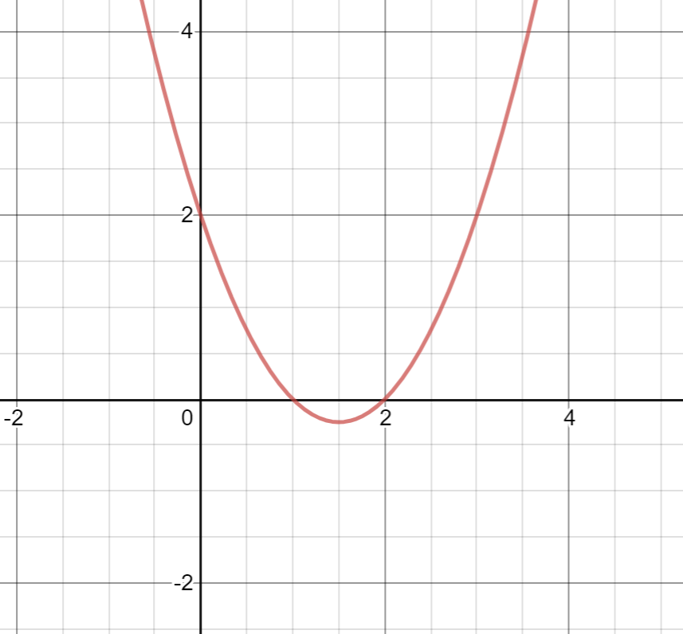

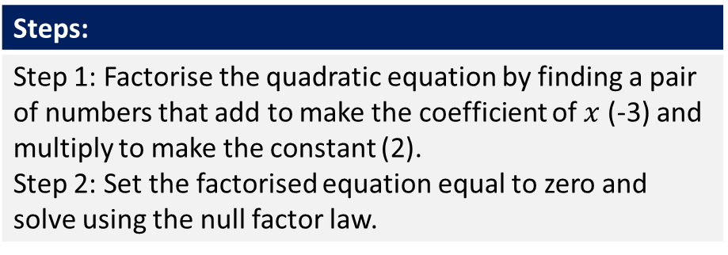


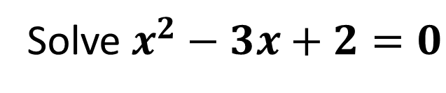




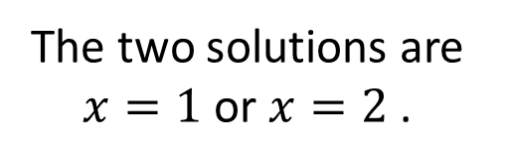
Daily Review
Steps:
Step 1: Factorise the quadratic equation by finding a pair of numbers that add to make the coefficient of $x$ (-3) and multiply to make the constant (2). Step 2: Set the factorised equation equal to zero and solve using the null factor law.
Solve $x^{2}−3x+2=0$
Step 1: Adds to make -3 and multiplies to make 2
- 1 and -2
$$x^{2}−3x+2=\left(x−1\right)\left(x−2\right)$$
$$\left(x−1\right)\left(x−2\right)=0$$
Step 2:
$$x−1=0$$
OR
$$x−2=0$$
$$+1$$
$$+1$$
+2
+2
$$x=−1$$
$$x=2$$
The two solutions are $x=1$or $x=2$ .

Slide 6
Learning Objective
CFU 1
What will we learn?
I will solve quadratic equations by rearranging and factorising.
CFU 2
What will we learn?
CFU 3
How will we know if we’ve been successful?
Success Criteria
CFU 4
How will we know if we’ve been successful?
I will be able to:
Rearrange quadratic equations.
Factorise monic quadratic expressions with positives and negatives.
Solve quadratic equations using the null factor law.

Slide 7

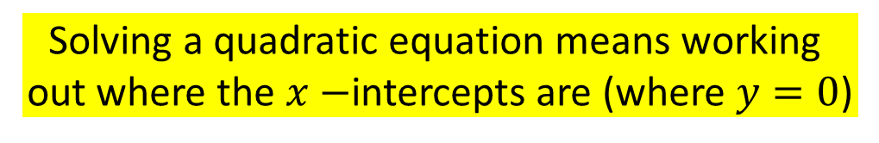

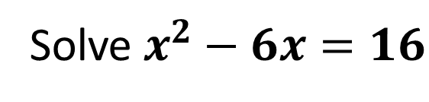
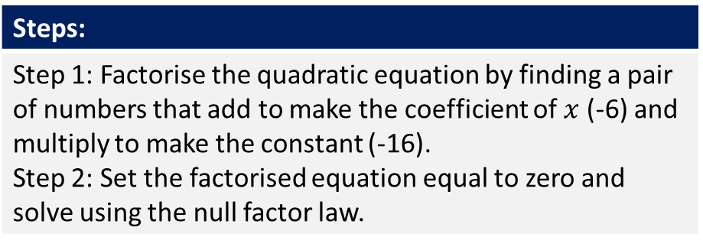
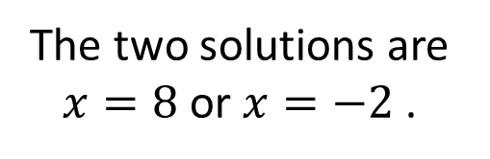


Concept Development
Solving a quadratic equation means working
out where the $x−$intercepts are (where $y=0$)
Solve $x^{2}−6x=16$
-16
-16
As this equation does not equal zero, we need to rearrange it so that it does!
$$x^{2}−6x−16=0$$
Step 1: Adds to make -6 and multiplies to make -16
-8 and 2
Steps:
Step 1: Factorise the quadratic equation by finding a pair of numbers that add to make the coefficient of $x$ (-6) and multiply to make the constant (-16). Step 2: Set the factorised equation equal to zero and solve using the null factor law.
$$x^{2}−6x−16=\left(x−8\right)\left(x+2\right)$$
$$\left(x−8\right)\left(x+2\right)=0$$
Step 2:
$$x−8=0$$
OR
$$x+2=0$$
The two solutions are $x=8$or $x=−2$ .

Slide 8


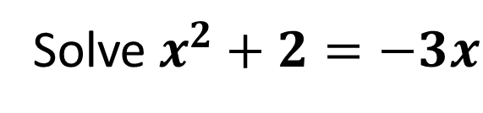

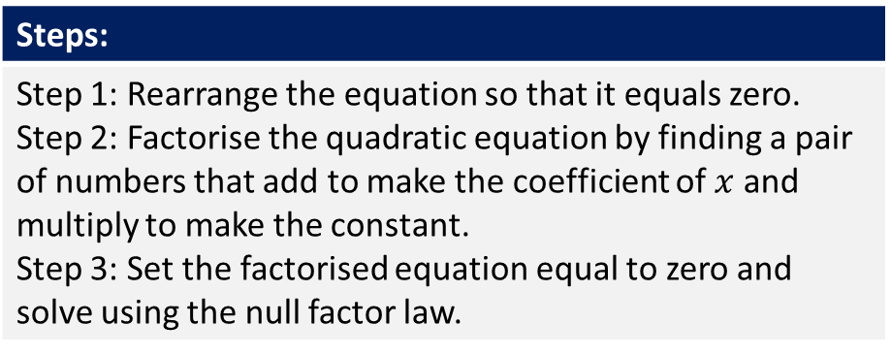
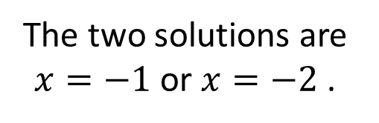
Skill Development/Guided Practice
Steps:
Step 1: Rearrange the equation so that it equals zero. Step 2: Factorise the quadratic equation by finding a pair of numbers that add to make the coefficient of $x$ and multiply to make the constant. Step 3: Set the factorised equation equal to zero and solve using the null factor law.
Solve $x^{2}+2=−3x$
+3x
+3x
$$x^{2}+3x+2=0$$
Step 1: Adds to make 3 and multiplies to make 2
1 and 2
$$x^{2}+3x+2=\left(x+1\right)\left(x+2\right)$$
$$\left(x+1\right)\left(x+2\right)=0$$
Step 2:
$$x+1=0$$
OR
$$x+2=0$$
The two solutions are $x=−1$or $x=−2$ .

Slide 9



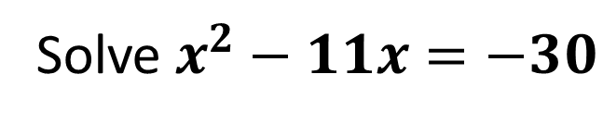

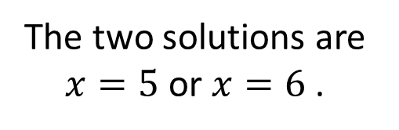
Skill Development/Guided Practice
Steps:
Step 1: Rearrange the equation so that it equals zero. Step 2: Factorise the quadratic equation by finding a pair of numbers that add to make the coefficient of $x$ and multiply to make the constant. Step 3: Set the factorised equation equal to zero and solve using the null factor law.
Solve $x^{2}−11x=−30$
+30
+30
$$x^{2}−11x+30=0$$
Step 1: Adds to make -11 and multiplies to make 30
-5 and -6
$$x^{2}−11x+30=\left(x−5\right)\left(x−6\right)$$
$$\left(x−5\right)\left(x−6\right)=0$$
Step 2:
$$x−5=0$$
OR
$$x−6=0$$
The two solutions are $x=5$or $x=6$ .

Slide 10



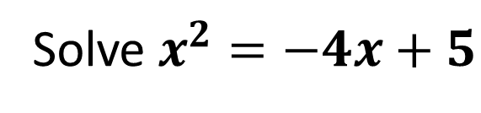


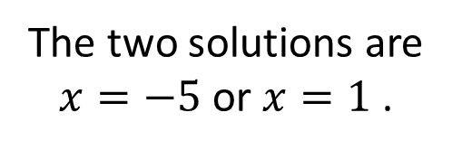
Skill Development/Guided Practice
Steps:
Step 1: Rearrange the equation so that it equals zero. Step 2: Factorise the quadratic equation by finding a pair of numbers that add to make the coefficient of $x$ and multiply to make the constant. Step 3: Set the factorised equation equal to zero and solve using the null factor law.
Solve $x^{2}=−4x+5$
+4x
+4x
$$x^{2}+4x=5$$
-5
-5
$$x^{2}+4x−5=0$$
Step 1: Adds to make 4 and multiplies to make -5
5 and -1
$$x^{2}+4x−5=\left(x+5\right)\left(x−1\right)$$
$$\left(x+5\right)\left(x−1\right)=0$$
Step 2:
$$x+5=0$$
OR
$$x−1=0$$
The two solutions are $x=−5$or $x=1$ .

Slide 11
Independent Practice
Steps:
Step 1: Rearrange the equation so that it equals zero. Step 2: Factorise the quadratic equation by finding a pair of numbers that add to make the coefficient of $x$ and multiply to make the constant. Step 3: Set the factorised equation equal to zero and solve using the null factor law.
Solve $x^{2}=−4x+5$
+4x
+4x
$$x^{2}+4x=5$$
-5
-5
$$x^{2}+4x−5=0$$
Step 1: Adds to make 4 and multiplies to make -5
5 and -1
$$x^{2}+4x−5=\left(x+5\right)\left(x−1\right)$$
$$\left(x+5\right)\left(x−1\right)=0$$
Step 2:
$$x+5=0$$
OR
$$x−1=0$$
The two solutions are $x=−5$or $x=1$ .

